Slide 1
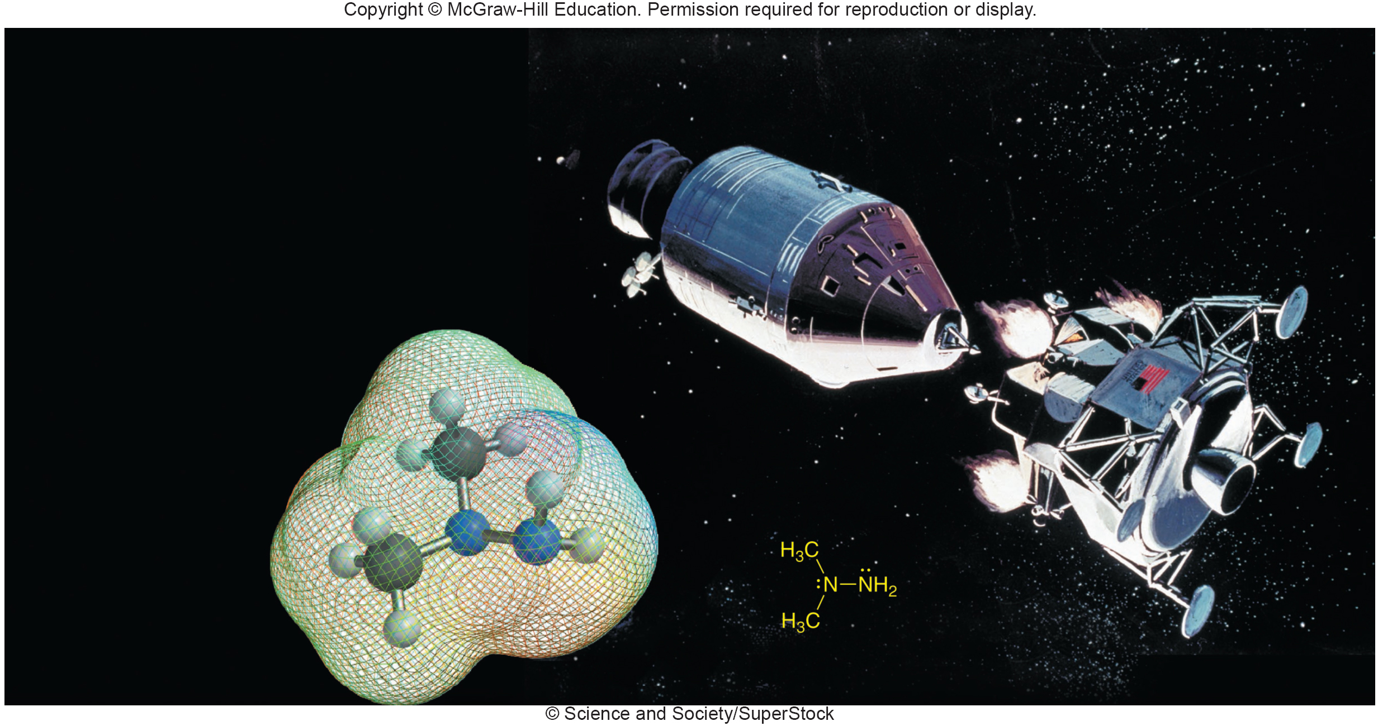
Chapter 1
Structure Determines Properties

Slide 2
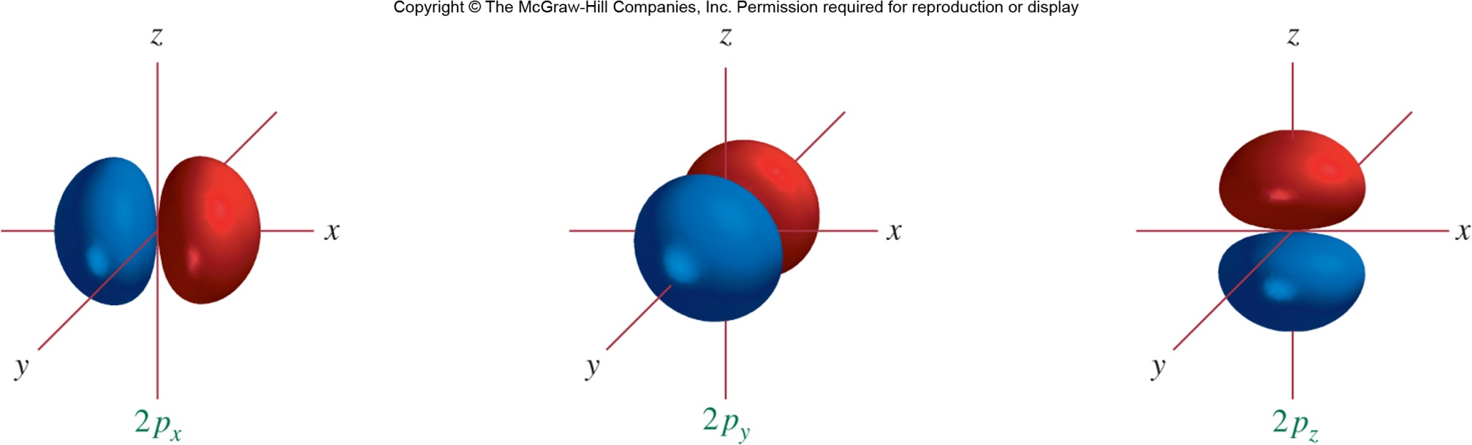
Atoms, Electrons, and Orbitals
Section 1.1

Slide 3
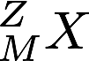
Particles and Symbols of the Atom
Neutron
Mass = 1.67 × 10^{–27} kg
Charge = 0.00 C
Electron
Mass = 9.11 × 10^{–31} kg
Charge = –1.60 × 10^{–19} C
Proton
Mass = 1.67 × 10^{–27} kg
Charge = +1.60 × 10^{–19} C
The number of protons in the nucleus is called the atomic number (Z).
The total number of nuclear particles is called the mass number (M).

Slide 4
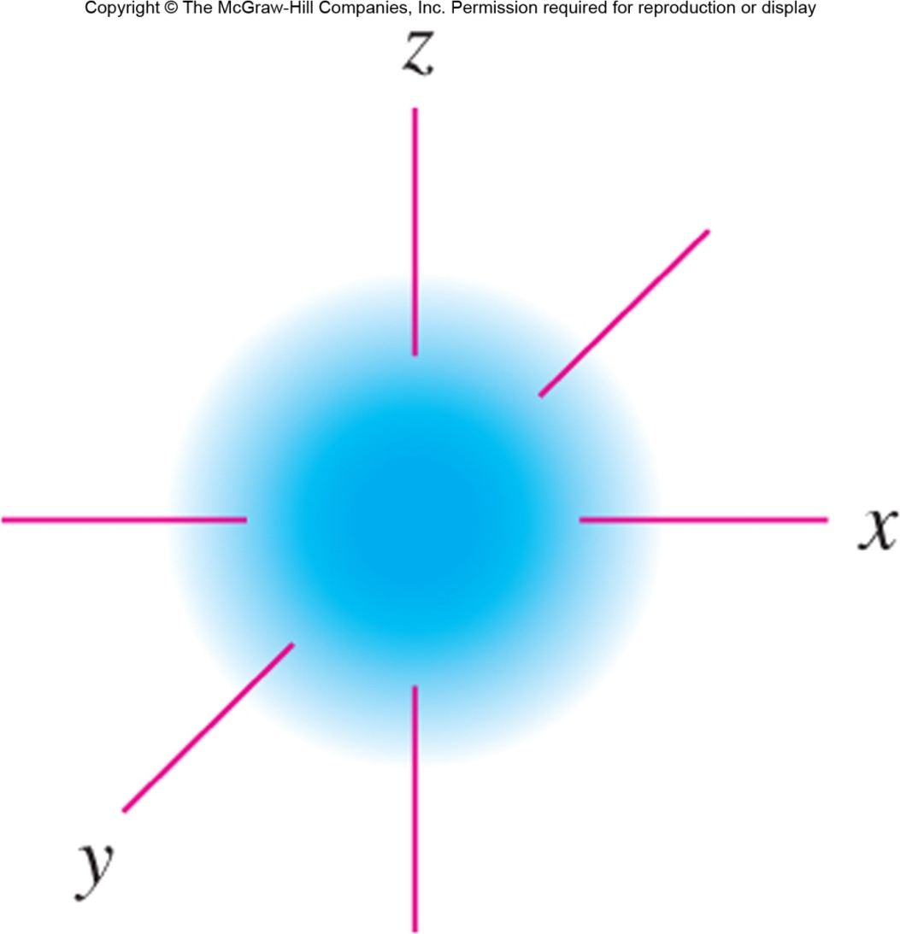
Electrons as Waves
Electrons in atoms and molecules behave as waves rather than particles
The wavelike behavior of electrons is captured by the wavefunction (ψ) or orbital
Every electron has an associated orbital; the electron occupies the orbital
The shape of an orbital reflects the probability density of the electron over space
The energy of an orbital reflects the stability of an electron within it
The probability density p(r) at a point r is related to |ψ|²
The Schrödinger equation

Slide 5
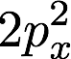
Quantum Numbers
Atomic orbitals are associated with quantum numbers that characterize the energy and shape of the orbital
Principal quantum number (n): related to the energy of the orbital
Orbital quantum number (l): related to the shape of the orbital
Magnetic quantum number (m_{l}): related to the shape and directionality of the orbital
Spin quantum number (s): related to the magnetic properties of the electron
Principal QN
The Pauli exclusion principle states that no two electrons in an atom or molecule can share the same set of quantum numbers.
Orbital QN
Spin +1/2 & –1/2 implied
Magnetic QN

Slide 6
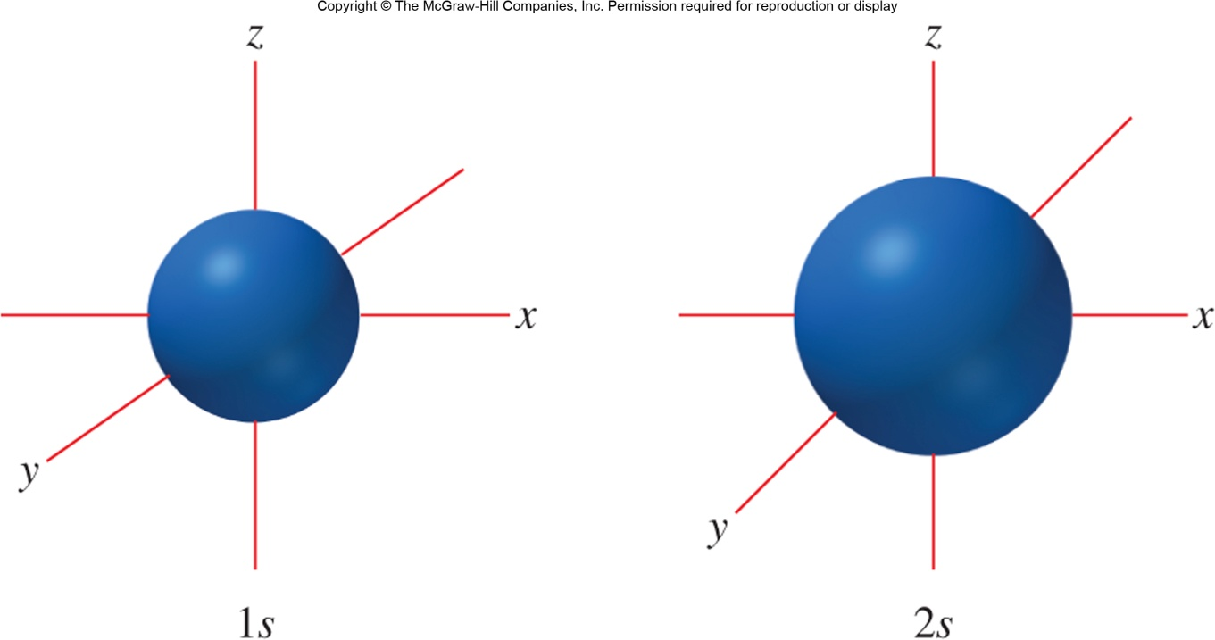
The s Atomic Orbitals
The s atomic orbitals begin at n = 1 and are spherically shaped
There is a single orbital within each ns subshell
Within a particular shell, s orbitals are lower in energy than other orbitals
As n increases, additional sign changes (nodes) appear in the shape of the orbital

Slide 7

The p Atomic Orbitals
The p atomic orbitals begin at n = 2 and are dumbbell shaped
There are 3 orbitals within each np subshell, which correspond to the three Cartesian directions
The np orbitals all have the same energy; according to Hund’s rule electrons are left unpaired when filling until they must be paired
All p orbitals contain a node at the nucleus

Slide 8
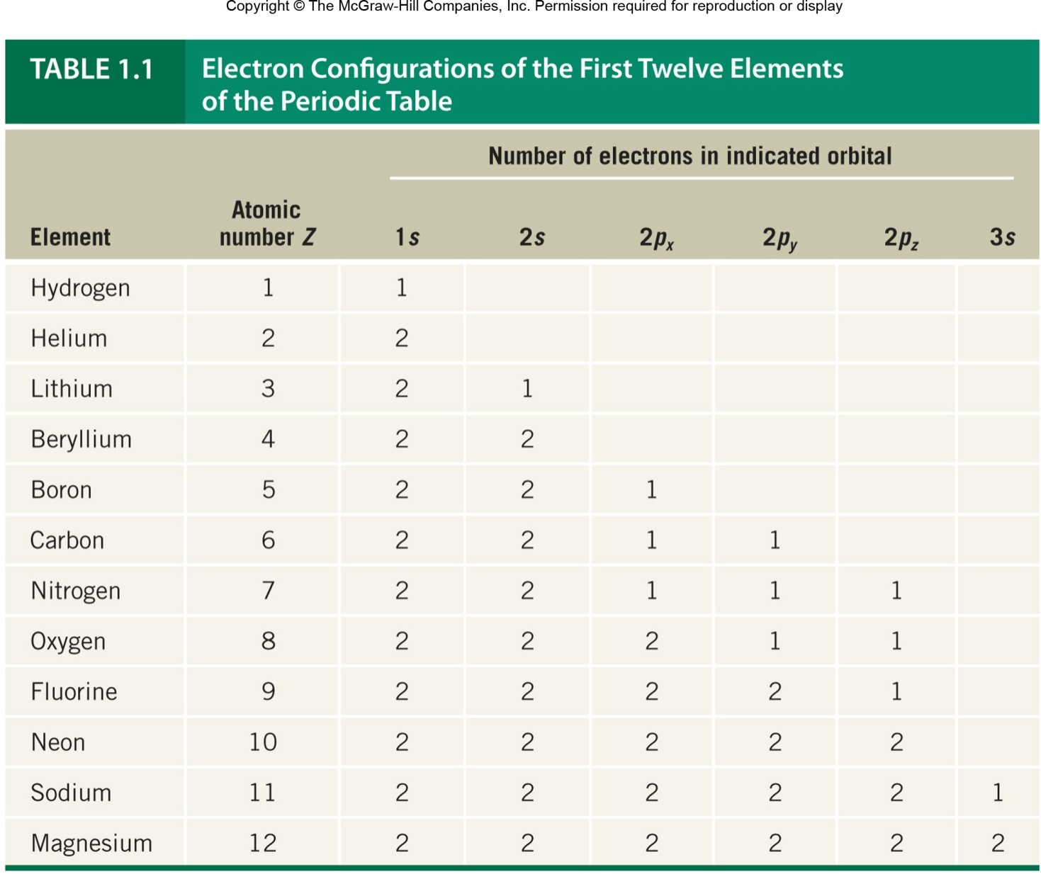
Atomic Electron Configurations

Slide 9
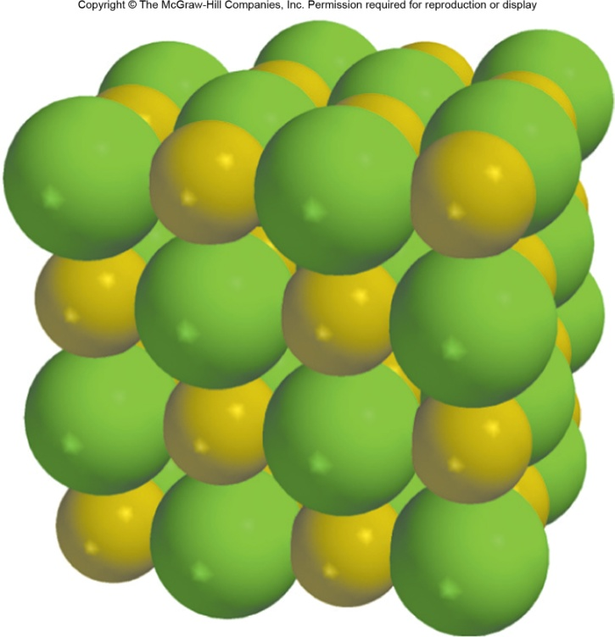
Ionic Bonds
Section 1.2

Slide 10

Coulomb’s Law and Ionic Bonding
Ions are atoms or molecules with electric charge. Oppositely charged ions attract one another according to Coulomb’s law
The resulting attraction is known as an ionic bond
Ions pack into tightly clustered lattices in ionic compounds
High-melting solids
Soluble in polar solvents

Slide 11
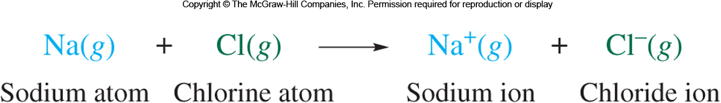
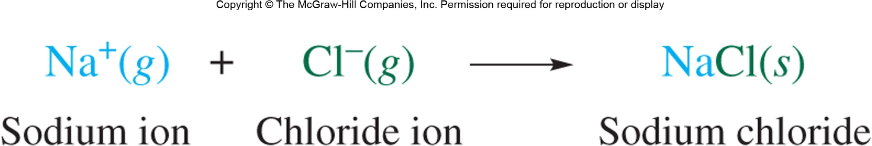
Ionic Bonding and Electron Transfer
One can imagine ionic bonds as arising from the transfer of an electron from a metal to a nonmetal
For example, gaseous sodium can transfer an electron to gaseous chlorine…
This process is endothermic (ΔHº = +147 kJ/mol), but the formation of solid NaCl is strongly exothermic
Gaseous Na and Cl spontaneously form solid NaCl.

Slide 12
Ionic Bonding in Organic Chemistry
Carbon atoms rarely form ions; hence, ionic bonds are rare in organic chemistry
Covalent bonds involving the sharing of electrons between nonmetal atoms are much more common
Ionic bonds do appear in salts of C, N, O, and H which are nucleophilic (electron-donating) at the nonmetal atom

Slide 13

Covalent Bonds, Lewis Formulas, and the Octet Rule
Section 1.3

Slide 14
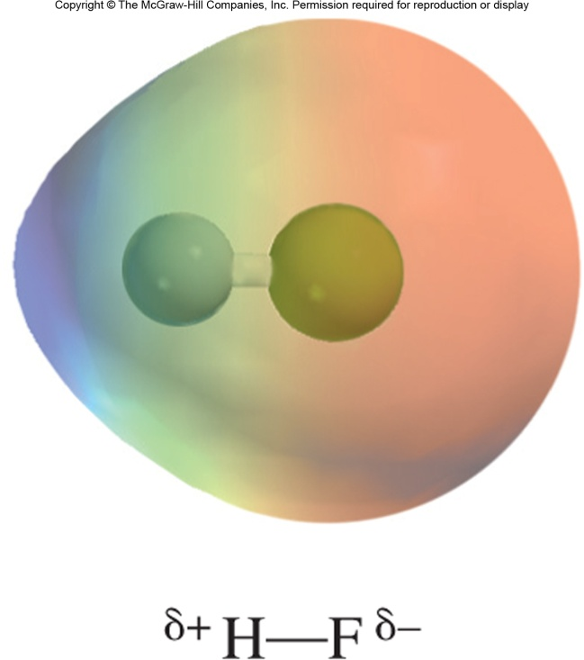
The Lewis Model of Covalent Bonding
Covalent bonds involve the sharing of electrons between two atoms
Atoms share electrons to achieve a more stable electron configuration
Maximum stability is reached when an atom achieves a full valence shell, isoelectronic with the nearest noble gas
Electrons may not be shared equally—covalent bonds may be polarized!
e–
e–

Slide 15
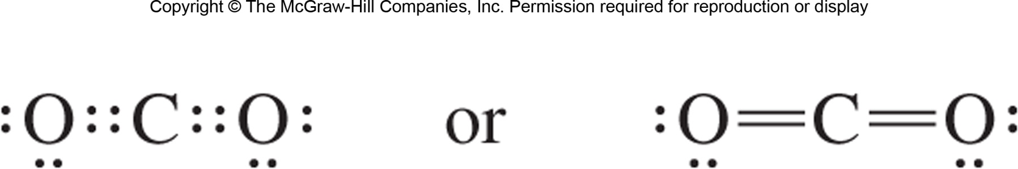
Lewis Symbols and Structures
In Lewis structures, electrons are represented as dots or lines. A line denotes a pair of electrons (2) shared in a covalent bond; atomic symbols denote atoms + core e–’s
Not all electrons will be involved in covalent bonding; unshared pairs are drawn as dots on the edges of their associated atoms
Key premise: electrons are localized on a single atom or between two atoms

Slide 16
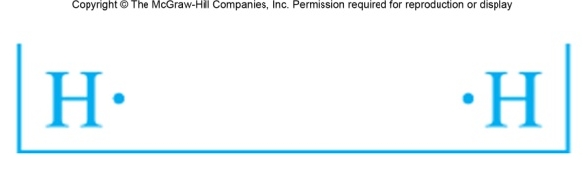
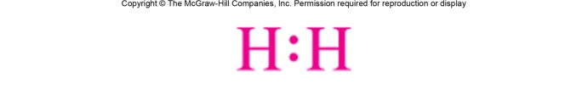
Covalent Bonding in H₂
A neutral hydrogen atom needs one more valence electron to achieve a full valence shell
Two hydrogens sharing their valence electrons achieve a full n = 1 shell
In H₂, the electron configuration of each hydrogen atom is analogous to that of helium, the first noble gas
Two dots or a line between two atoms denotes the sharing of two electrons between the atoms in a covalent bond.

Slide 17
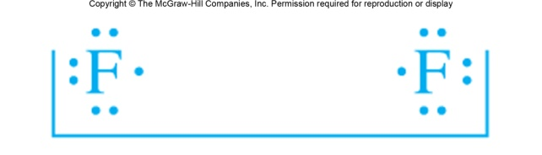
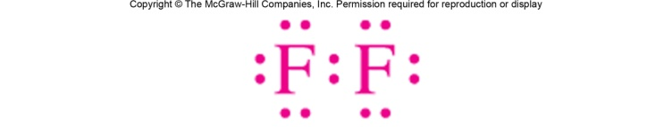
Covalent Bonding in F₂
A neutral fluorine atom needs one more valence electron to achieve a full valence shell
Two hydrogens sharing their valence electrons achieve a full n = 2 shell containing 8 electrons
In F₂, the electron configuration of each hydrogen atom is analogous to that of neon, the second noble gas
The six electrons on the periphery of each fluorine are nonbonding electron pairs or lone pairs.

Slide 18
The Octet Rule
For second-row elements, a full valence shell contains electrons in the 1s, 2p_{x}, 2p_{y}, and 2p_{z} orbitals
A full n = 2 valence shell is called an octet because it contains eight electrons
The octet rule: in stable molecules, second-row atoms share electrons until they achieve an octet
When checking that the octet rule is satisfied, double-count shared electrons (once for each atom involved in sharing)
2 + 2 + 2 + 2 = 8
Each fluorine has an octet of electrons.

Slide 19
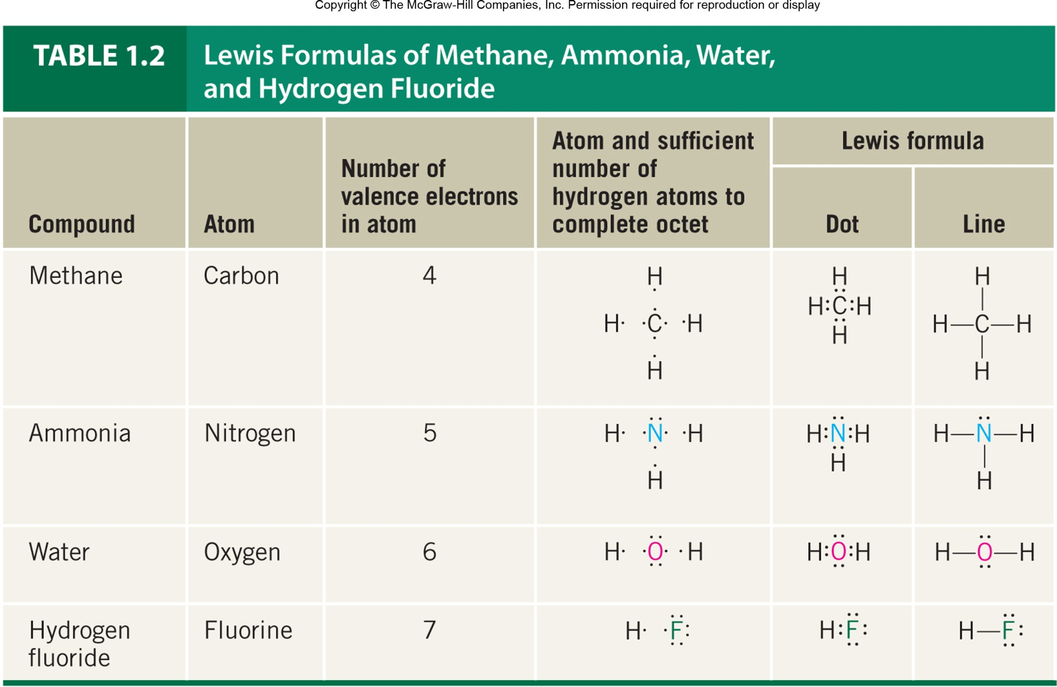
Examples of Lewis Structures

Slide 20
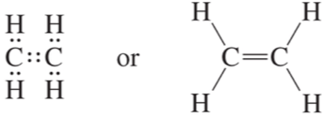
Multiple Bonds
More than two electrons can be shared between atoms. This is often necessary to satisfy the octet rule!
When four or six electrons are shared, a multiple bond results
Double bond: four electrons are shared (2 × 2)
Triple bond: six electrons are shared (3 × 2)

Slide 21
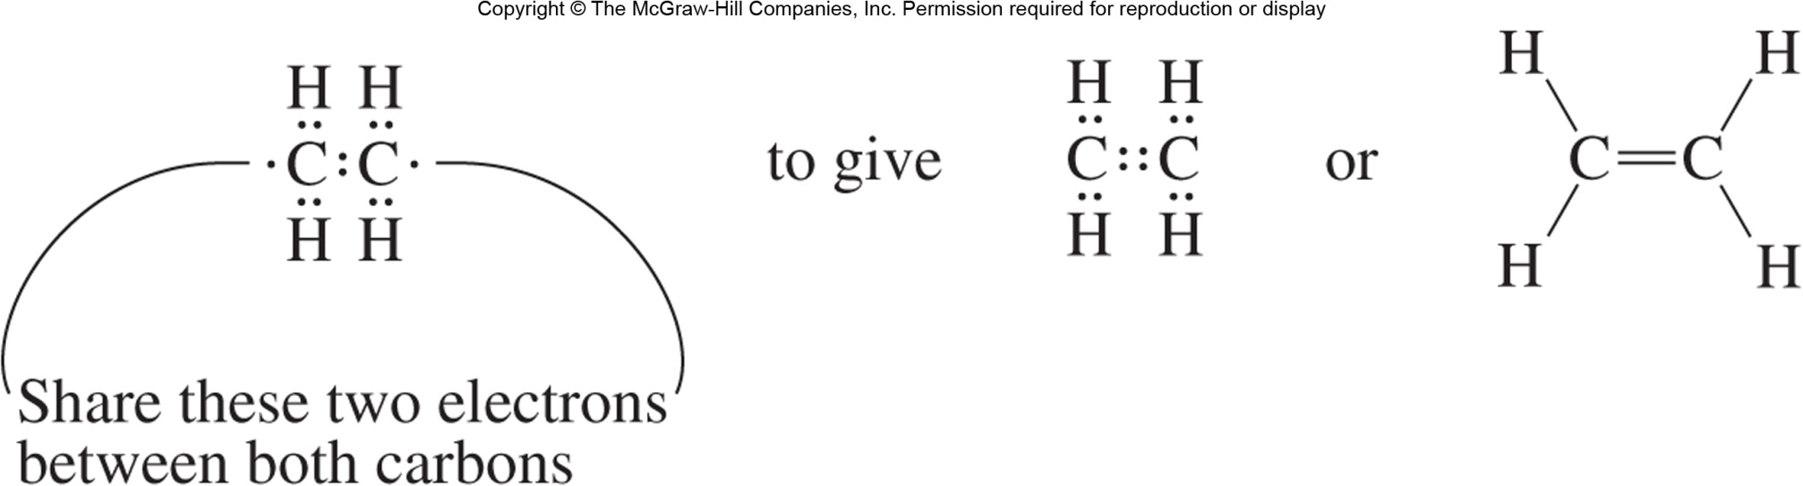
Double Bonds
To draw the Lewis structure of ethylene (C₂H₄), we must share four electrons between the carbon atoms to achieve octets on both
Only seven electrons!
Eight electrons (an octet)

Slide 22

Triple Bonds
To draw the Lewis structure of ethyne (C₂H₂), we must share six electrons between the carbon atoms to achieve octets on both
Eight electrons (an octet)

Slide 23
Polar Covalent Bonds, Electronegativity, and Bond Dipoles
Section 1.4

Slide 24
Electronegativity
Electronegativity is defined as the ability of an atom to attract electrons to itself
Electronegative atoms attract electrons strongly, hold their electrons tightly, and tend to take on electrons
Electropositive atoms attract electrons weakly and may give up electrons
e–
e–
Electronegativity helps us predict the relative reactivity of analogous compounds. Recalling trends in electronegativity is extremely important!
e–
e–

Slide 25
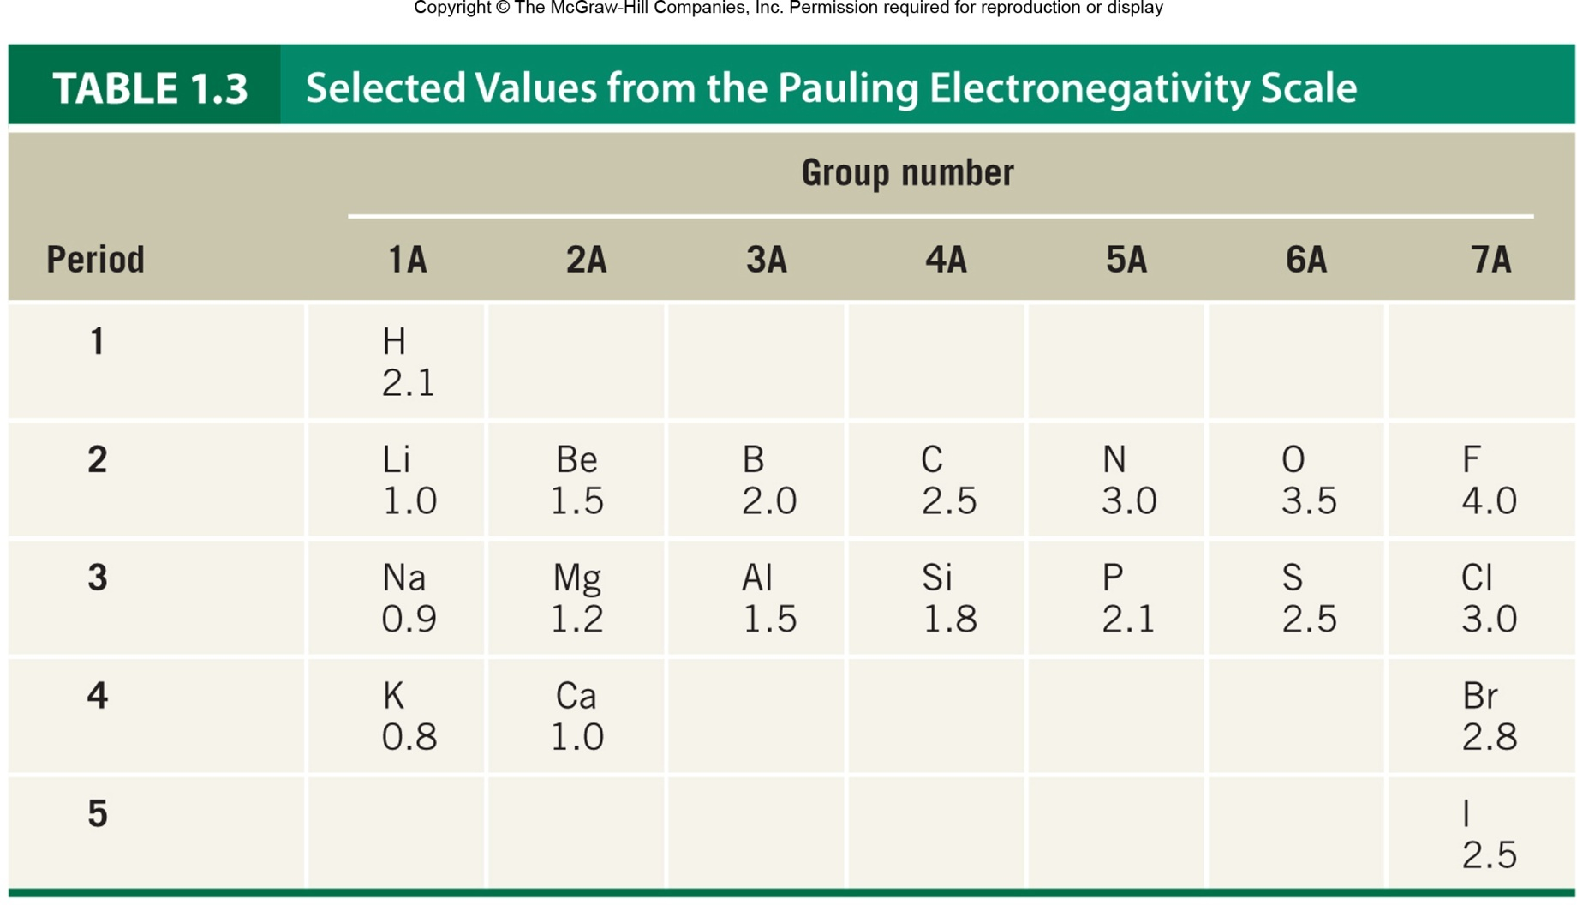
Periodic Trends in Electronegativity
Electronegativity increases from left to right across a period and from bottom to top within a group.

Slide 26
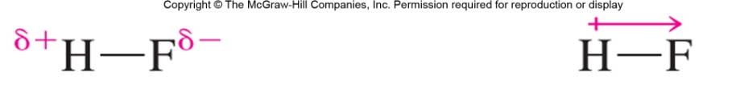
Polar Covalent Bonds
Two atoms of different electronegativities share electrons unequally in a covalent bond. The result is a polar covalent bond
The greater the difference in electronegativity, the more polarized the bond
Partial positive charge
Partial negative charge
The dipole moment vector points from the positive end to the negative end.
Polar covalent bonds tend to be sites of reactivity in organic molecules.

Slide 27

Electrostatic Potential Maps
The model of molecular charge as a dipole is a simplification; in reality molecules contain a spatial distribution of charge
An electrostatic potential (ESP) map shows the distribution of charge over a molecule
Red regions are partially negative and have an excess of electron density.
Blue regions are partially positive and lack electron density.

Slide 28
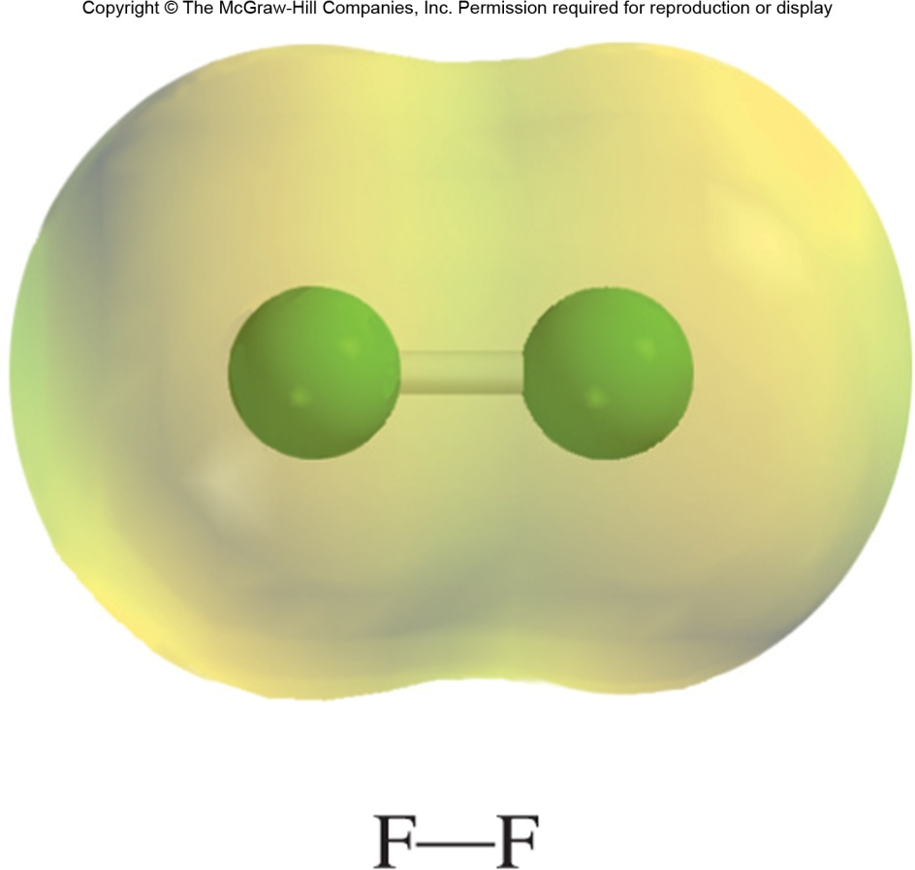
Electrostatic Potential Maps
The model of molecular charge as a dipole is a simplification; in reality molecules contain a spatial distribution of charge
An electrostatic potential (ESP) map shows the distribution of charge over a molecule
Nonpolar molecules contain unpolarized bonds and/or a symmetric distribution of charge.

Slide 29
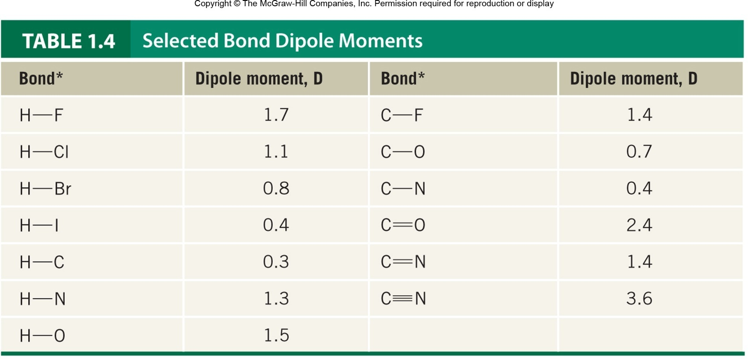
A Selection of Dipole Moments
More polarized bonds are associated with greater differences in electronegativity and greater dipole moments.

Slide 30
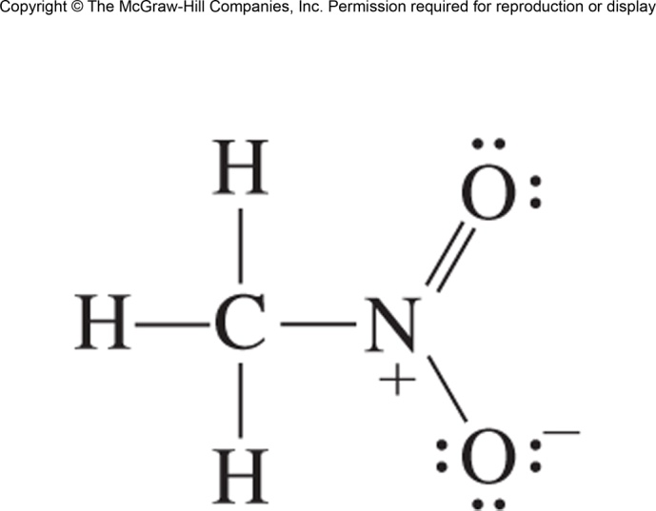
Formal Charge
Section 1.5

Slide 31
Formal Charge
Within a Lewis structure, an atom may not have a formal number of electrons equal to the valence electron count of the neutral atom
In this case, the atom has nonzero formal charge
To calculate formal charge, subtract the valence electron count of the neutral atom (VEC) from the formal valence electron count of the covalently bound atom (FEC)
Formal charges with magnitude greater than 1 are not encountered in organic molecules.

Slide 32
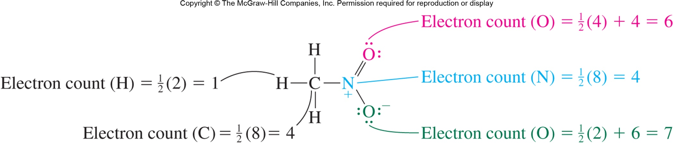
Calculating Formal Charge
To calculate the formal valence electron count of an atom, count all unshared electrons and half of all bonding electrons
Refer to the periodic table (group number) for the number of valence electrons in the neutral atom
A neutral oxygen atom has 6 valence electrons; the formal charge of this O is thus 6 – 7 = –1.

Slide 33
Calculating Formal Charge
Stay on the lookout for structural patters associated with formal charge, such as nitrogen with four bonds and oxygen with one bond
A neutral nitrogen atom has 5 valence electrons; the formal charge of N is thus 5 – 4 = +1.
A neutral oxygen atom has 6 valence electrons; the formal charge of this O is thus 6 – 7 = –1.

Slide 34
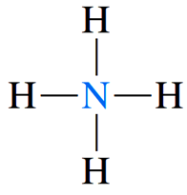
Formal Charge in NH₄⁺
A neutral nitrogen atom contains 5 electrons (Group 5A)
The nitrogen atom in NH₄ has a formal valence electron count of 0.5 × 8 = 4
The formal charge of nitrogen is thus 5 – 4 = +1

